Slide 1
Portfolio Theory III: Selection of optimal portfolios
Dr. Natasha Todorovic

Slide 2
The portfolio-choice problem
02
The efficient frontier narrows down the choice. Investor select ONE portfolio based on their preferences
Efficient frontier
Optimal portfolio
Highest expected return for a given volatility, or lowest volatility for a given expected return.
The efficient portfolio that gives the individual investor the highest utility
Key questions:
What is utility?
How much extra expected return does investor require to accept more risk?
Notes:
Source: Markowitz (1952, 1959); adapted for Securities and Investments lecture notes.

Slide 3
Utility

Slide 4
Utility
Utility = welfare or the level of ‘satisfaction’ of investors
In economics: Utility from goods and services
  Level of satisfaction expressed in utils
  No risk, so no decrease in utility (disutility) when goods or services increase
In finance: Utility from wealth derived by investing in risky assets
  Two sources affect utility in opposite direction: expected return and standard deviation
  Utility increases with higher return
  Utility decreases with higher standard deviation
  The degree of risk aversion determines how much decrease in utility occurs
  This decrease in utility when risk increases is driven by the degree of risk aversion of investor, which will determine the level of risk premium expected from an investment: the more risk averse we are, the more risk premium we want

Slide 5
Deriving utility from risky (uncertain) investments
Investors evaluate uncertain wealth through expected utility, rather than expected value of wealth alone
  Expected value of wealth does not capture attitudes to uncertainty but investor’s utility function does
  Investor will choose the investment that provides them with highest level of expected utility
The formula of expected utility:
E (U) = Σ p_{i} x U(A_{i})
  where p_{i} is the probability of risky outcome A_{i} occurring and U(A_{i}) is the corresponding utility of that outcome. The expected utility of a risky investment is simply a weighted average of the possible utilities and associated probabilities

Slide 6

Expected Utility Example
Consider an investor whose utility function is given by:
Calculate the expected value (E(A)) of investment and the expected utility (E(U)) this investor derives from portfolio A if you are given the following possible outcomes:
Solution: E(A) = 6% ; E(U) = 5.685
Note: two investments can have the same expected value but different expected utilities!
Portfolio A | Rate of return | Probability
Outcome 1 | -3% | .25
Outcome 2 | 9% | .75

Slide 7
Risk Aversion

Slide 8
The Concept of Risk Aversion
Consider the following two investments:
  Investment X is certain: receive $10 with certainty (risk-free)
  Investment Y is uncertain: receive $100 with a 10% probability and $0 with a 90% probability
  Note: the value of certain investment X is equal to the expected value of the investment Y (=10%* $100+90%* $0 = $10) – this is called a ‘fair gamble’
Bases on attitudes towards ‘fair gamble’, Markowitz (1959) introduced the following definitions of risk aversion: risk averse, risk seeking and risk neutral

Slide 9
Risk averse, risk seeking and risk neutral investors
  Given the example on previous slide, investors with different attitudes towards risk will make different choice if faced with X vs.Y dilemma, i.e. the ‘fair gamble’:
    An investor who prefers the risky investment Y is risk seeking, he accepts ‘fair gamble’
    The one who is indifferent between the certain investment X and a risky investment Y is risk neutral and
    The investor who prefers the certainty (investment X) is risk averse investor, he rejects ‘fair gamble’

Slide 10
Risk averse, risk seeking and risk neutral investors
Let’s express investor’s risk aversion in the context of utility (investor’s level of ‘happiness’)
Remember, an investor will choose the investment with higher utility:
  An investor is risk averse if the utility of certain investment is greater than expected utility of risky investment
    Therefore, a fair gamble does not reduce expected wealth, but it reduces expected utility for a risk-averse investor
  An investor is risk seeking if the utility of certain investment is smaller than expected utility of risky investment
  An investor is risk neutral if the utility of certain investment is the same as the expected utility of risky investment

Slide 11
Rational investors’ attitude towards risk
Risk averse investor: rejects ‘fair gamble’ – they expect positive risk premium
Risk neutral investor is indifferent – they expect zero risk premium
Risk seeking investor accepts ‘fair gamble’- they accept negative risk premium
The only rational behaviour is that of a risk averse investor

Slide 12
How do we quantify utility? Examples of utility functions
If A is wealth, then utility functions can for instance be expressed as:
U = √A
U = ln(A)
U = A²
U= A^{-cA2}
U= -e^{-cA}
…
Each function reflects investor’s level of risk aversion - different for different investors.
Utility functions are primarily a theoretical representation of investor preferences.
In practice, investors rarely specify an explicit mathematical utility function - their preferences are usually translated into portfolio objectives and risk constraints.

Slide 13
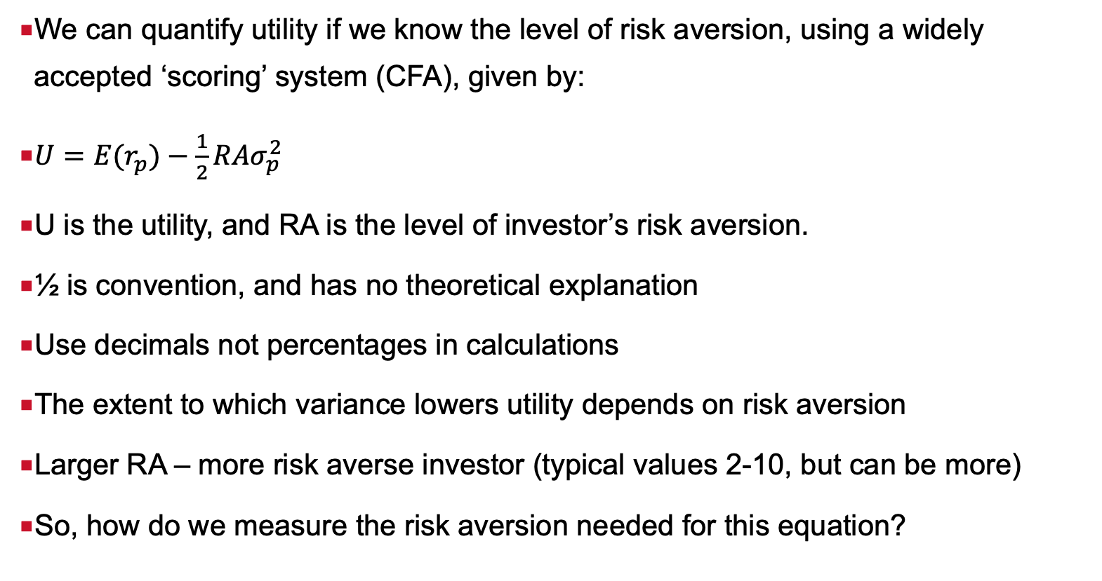
Establish the link between utility and risk aversion
We can quantify utility if we know the level of risk aversion, using a widely accepted ‘scoring’ system (CFA), given by:
$U={E(r}_{p})−\frac{1}{2}RAσ_{p}^{2}$
U is the utility, and RA is the level of investor’s risk aversion.
½ is convention, and has no theoretical explanation
Use decimals not percentages in calculations
The extent to which variance lowers utility depends on risk aversion
Larger RA – more risk averse investor (typical values 2-10, but can be more)
So, how do we measure the risk aversion needed for this equation?

Slide 14
How do we derive the level of risk aversion?
Finance theory: various measures of risk aversion computed from utility functions
  Arrow-Pratt risk aversion
      Absolute Risk Aversion (ARA)
      Relative Risk Aversion (RRA)
      Various versions of above models from academic studies
Finance practice:
  Scoring system: Investors assign a ‘score’ to to alternative portfolios on the basis of their expected return and risk
    Investor questionnaires
  Derive the risk premium for the ‘market’
  Infer risk premium from existing investments

Slide 15
Absolute risk aversion (ARA)
Measures how the investors preferences towards investing in risky assets changes when there is a change in wealth
If investor chooses to increase the number of dollars held in the risky asset in the portfolio as their wealth increased, we say that their absolute risk aversion is decreasing
If investor chooses to decrease the number of dollars held in the risky asset in the portfolio as their wealth increased, we say that their absolute risk aversion is increasing.
If investor chooses to keep the same number of dollars held in the risky asset in the portfolio as their wealth increased, we say that their absolute risk aversion is constant.
Most common behavior is decreasing ARA, but it can be constant or increasing

Slide 16
Relative risk aversion
Shows the percentage change of investment in the risky asset as wealth increases
RRA can be constant, increasing, decreasing
Most common behavior: constant RRA.
  As wealth increases, the proportion of the wealth invested in risky asset remains the same

Slide 17
HARA – risk tolerance
Measure of risk tolerance rather than risk aversion
Hyperbolic absolute risk aversion (HARA) gives us level of tolerance which is reciprocal to the level of absolute risk aversion.
If ARA is decreasing, HARA is increasing

Slide 18
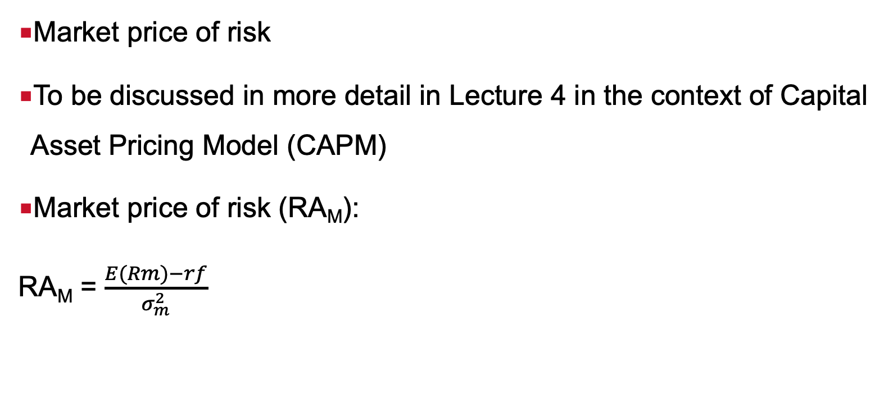
Risk aversion in the market as a whole
Market price of risk
To be discussed in more detail in Lecture 4 in the context of Capital Asset Pricing Model (CAPM)
Market price of risk (RA_{M}):
RA_{M} = $\frac{E(Rm)−rf}{σ_{m}^{2}}$

Slide 19
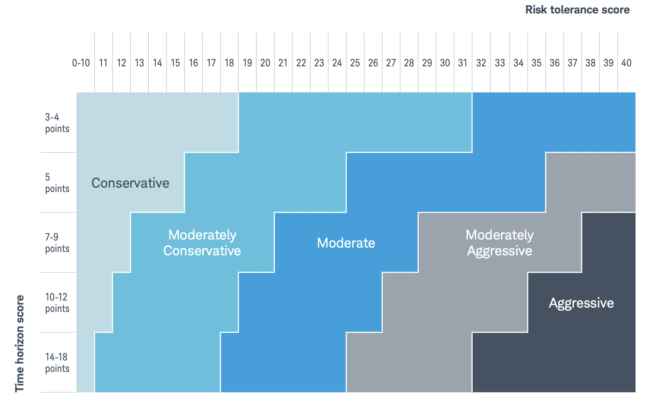
Risk questionnaires
Example of questionnaire: https://bynder.schwab.com/m/e5886818c0d507d/

Slide 20
Attitudes Towards Risk and Indifference Curves

Slide 21
Indifference curves
An indifference curve represents all combinations of expected return and risk that provide an investor with the same level of utility (satisfaction)
One indifference curve = one, constant, level of utility, i.e. the same, constant trade-off between risk and return
Positive marginal rate of substitution (MRS) for risk averse investors: an investor requires additional expected return to compensate for taking additional risk while maintaining the same level of utility.

Slide 22

Slope of indifference curves
MRS is the slope of the indifference curve, given by:
It depends on risk aversion (RA) of investors and volatility of investment (σ).
It can be:
  positive (risk averse)
  negative (risk seeking) or
  zero (risk neutral)
$$MRS=RAxσ_{A}$$

Slide 23
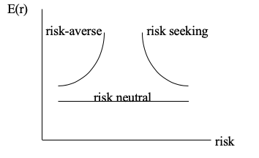



Slope of indifference curves (ICs) of different types of investors
The only rational investor is risk-averse, so we proceed with those ICs only

Slide 24
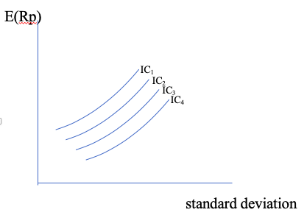
Indifference curves of one investor
All portfolios that are on one indifference curve provide investor with the same level of utility
Why do indifference curves have to be parallel?
Portfolios that lie on the indifference curve furthest ‘northwest’ are the most desirable ones (IC₁ on the graph)
There is an infinite number of indifference curves for any investor

Slide 25
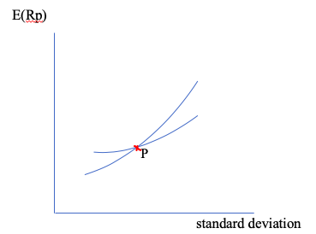
Why are indifference curves for one investor parallel?
If ICs of a single investor intersect, there will be a portfolio on the intersection (P on the graph) that lies on two indifferent curves, implying that it has two different levels of utility – that is not possible!

Slide 26
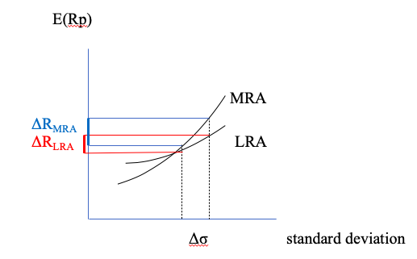
More risk averse vs. less risk averse investors
More risk averse (MRA) investors have steeper indifference curves

Slide 27
How to plot indifference curves

Slide 28
How to plot indifference curves
From the outcome of the questionnaire outcome, determine the value of RA
  Risk averse; RA>0,
  Risk neutral RA=0, not a rational investor
  Risk seeking RA<0, not a rational investor
Find the value of the risk-free rate
For the rest of the steps, see example on the next slide – to be discussed in tutorial

Slide 29
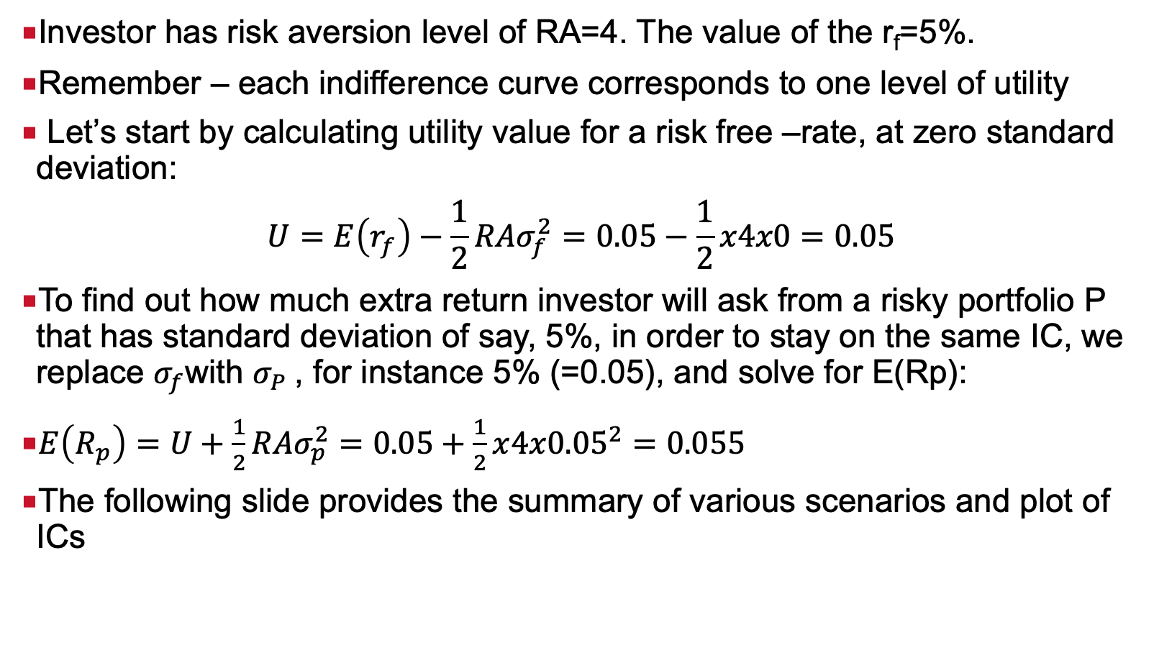
How to plot indifference curves - example
Investor has risk aversion level of RA=4. The value of the r_{f}=5%.
Remember – each indifference curve corresponds to one level of utility
Let’s start by calculating utility value for a risk free –rate, at zero standard deviation:
$$U=E\left(r_{f}\right)−\frac{1}{2}{RAσ}_{f}^{2}=0.05−\frac{1}{2}x4x0=0.05$$
To find out how much extra return investor will ask from a risky portfolio P that has standard deviation of say, 5%, in order to stay on the same IC, we replace $σ_{f}$with $σ_{P}$, for instance 5% (=0.05), and solve for E(Rp):
$E\left(R_{p}\right)=U+\frac{1}{2}{RAσ}_{p}^{2}=0.05+\frac{1}{2}x{4x0.05}^{2}=0.055$
The following slide provides the summary of various scenarios and plot of ICs

Slide 30
How to plot indifference curves - example
RA=4 | U | U | U
 | 0.05 | 0.09 | 0.12
Std. deviation | Exp return U=0.05 | Exp return U=0.09 | Exp return U=0.12
0 | 0.05 | 0.09 | 0.12
0.05 | 0.055 | 0.095 | 0.125
0.1 | 0.07 | 0.11 | 0.14
0.12 | 0.0788 | 0.1188 | 0.1488
0.15 | 0.095 | 0.135 | 0.165
0.17 | 0.1078 | 0.1478 | 0.1778
0.2 | 0.13 | 0.17 | 0.2
0.22 | 0.1468 | 0.1868 | 0.2168
0.25 | 0.175 | 0.215 | 0.245
0.3 | 0.23 | 0.27 | 0.3
0.35 | 0.295 | 0.335 | 0.365
0.4 | 0.37 | 0.41 | 0.44
0.45 | 0.455 | 0.495 | 0.525

Slide 31
Optimal Portfolio Selection

Slide 32
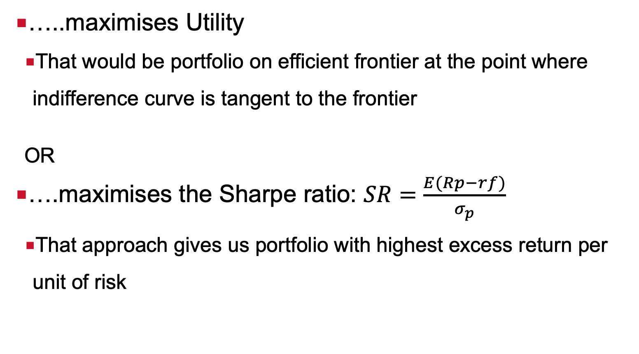
Optimal portfolio is the one that….
…..maximises Utility
  That would be portfolio on efficient frontier at the point where indifference curve is tangent to the frontier
  OR
….maximises the Sharpe ratio: $SR=\frac{E(Rp−rf)}{σ_{p}}$
  That approach gives us portfolio with highest excess return per unit of risk

Slide 33
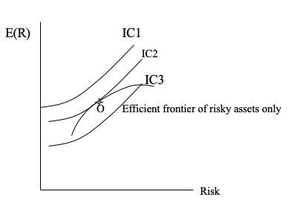
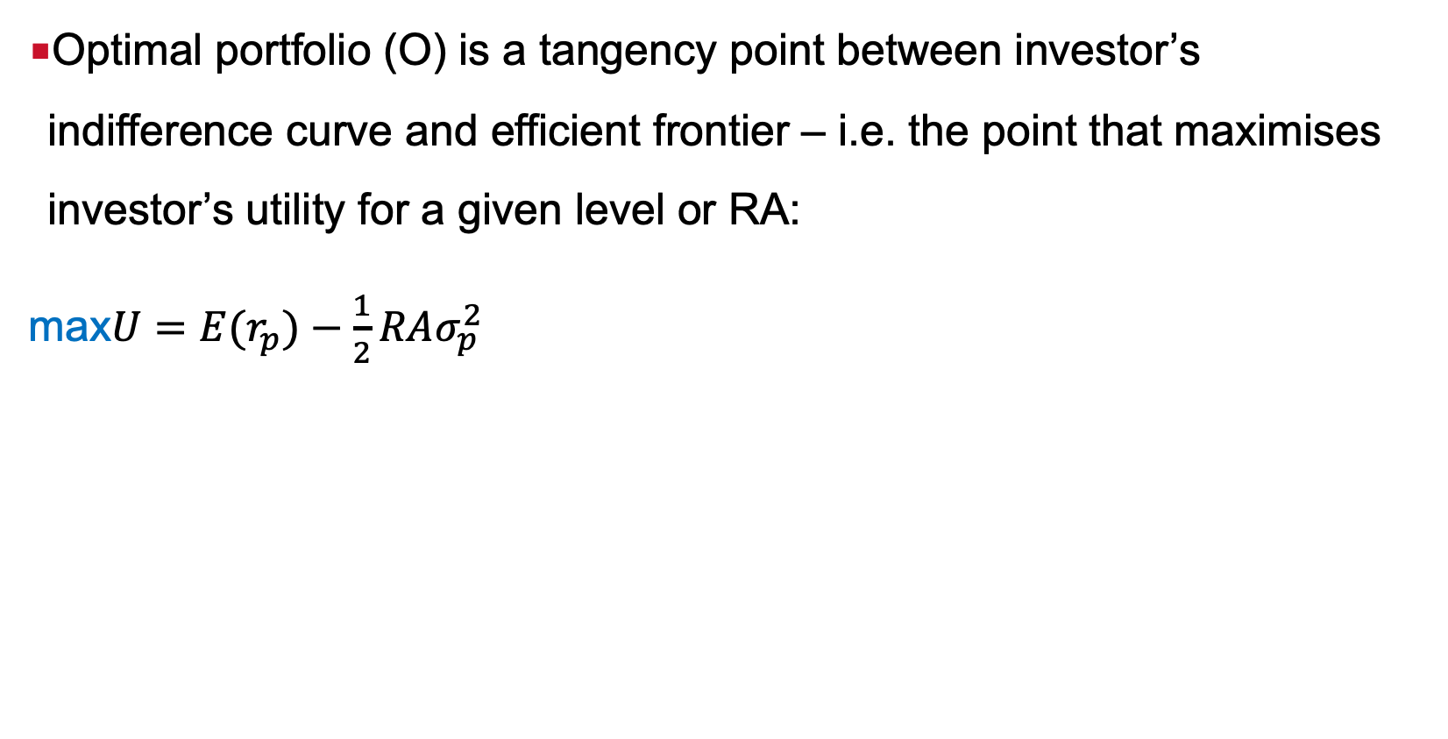
Selecting an optimal portfolio (O): Efficient frontier of risky assets only
Optimal portfolio (O) is a tangency point between investor’s indifference curve and efficient frontier – i.e. the point that maximises investor’s utility for a given level or RA:
max$U={E(r}_{p})−\frac{1}{2}RAσ_{p}^{2}$

Slide 34
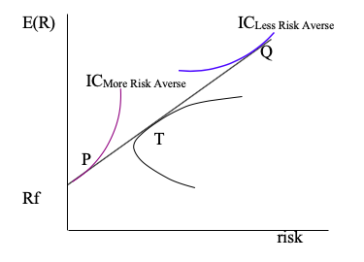
Selecting optimal portfolios on CAL: efficient frontier with risk-free lending and borrowing at the same rate
Capital Allocation Line (CAL): optimal portfolio that is investor’s choice is also known as COMPLETE portfolio (a combination of risky, maximum Sharpe ratio portfolio T and the risk free rate):
Capital Allocation Line

Slide 35
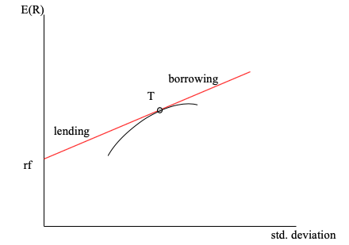
Optimal portfolio is always on the highest feasible indifference curve that maximises investor’s utility
Capital Allocation Line

Slide 36
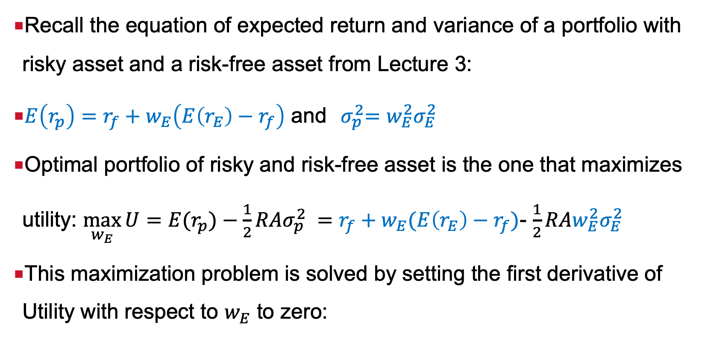
How to determine a point of optimal portfolio of risky and risk-free asset given the level of risk aversion?
Recall the equation of expected return and variance of a portfolio with risky asset and a risk-free asset from Lecture 3:
$E\left(r_{p}\right)=r_{f}+w_{E}\left(E\left(r_{E}\right)−r_{f}\right)$ and${ σ}_{p}^{2}=w_{E}^{2}σ_{E}^{2}$
Optimal portfolio of risky and risk-free asset is the one that maximizes utility: $\max_{w_{E}}{U={E(r}_{p})−\frac{1}{2}RAσ_{p}^{2} }=$ $r_{f}+w_{E}(E\left(r_{E}\right)−r_{f})$- $\frac{1}{2}RAw_{E}^{2}σ_{E}^{2}$
This maximization problem is solved by setting the first derivative of Utility with respect to $w_{E}$ to zero:

Slide 37
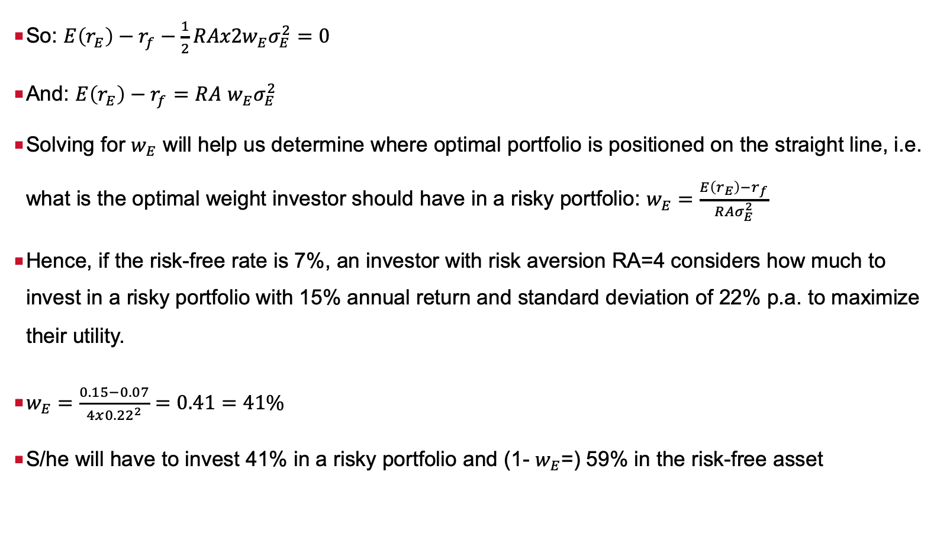
How to determine a point of optimal portfolio of risky and risk-free asset given the level of risk aversion?
So: $E\left(r_{E}\right)−r_{f}−\frac{1}{2}RAx2w_{E}σ_{E}^{2}=0$
And: $E\left(r_{E}\right)−r_{f}=RA$ $w_{E}σ_{E}^{2}$
Solving for $w_{E}$ will help us determine where optimal portfolio is positioned on the straight line, i.e. what is the optimal weight investor should have in a risky portfolio: $w_{E}=\frac{E\left(r_{E}\right)−r_{f}}{RAσ_{E}^{2}}$
Hence, if the risk-free rate is 7%, an investor with risk aversion RA=4 considers how much to invest in a risky portfolio with 15% annual return and standard deviation of 22% p.a. to maximize their utility.
$w_{E}=\frac{0.15−0.07}{4x{0.22}^{2}}=0.41=41\%$
S/he will have to invest 41% in a risky portfolio and (1- $w_{E}$=) 59% in the risk-free asset

Slide 38
Optimal portfolio selection: maximisation of Sharpe ratio
Maximum Sharpe ratio method derives optimal portfolio as a portfolio is a portfolio of risky assets where linear efficient frontier reaches its maximum slope – i.e. the tangency portfolio T!
Refer to excel file and video for demonstration of optimal portfolio selection
    Portfolio that maximizes Utility and how to plot ICs is also shown in the same video

Slide 39
References
Relevant parts of Chapter 6, BKM
Parts of Chapter 11, EGMG

